Slide 1
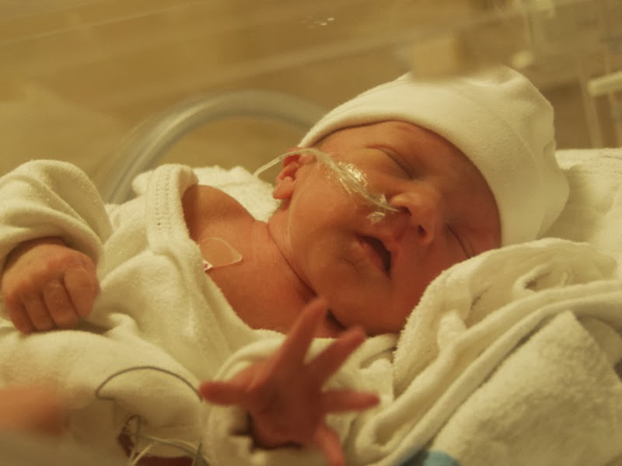



Dr. P. K. Rajiv
Head of Department
Department of Neonatology
NMC Specialty Hospital
Dubai, UAE
.
Formerly:
Professor & HOD
Department of Neonatology
Amtita institute of medical sciences, Kochi, Kerala, India

Slide 2


The World Health Organization (WHO) estimates that globally, between four and nine million newborns suffer birth asphyxia each year. Of those, an estimated 1.2 million die and almost the same number develop severe consequences.
The WHO also estimates that globally, 29% of neonatal deaths are caused by birth asphyxia
(

Slide 3

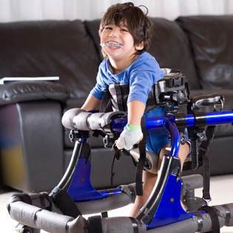
As many as 80% of infants who survive severe hypoxic-ischemic encephalopathy develop serious complications, 10-20% develop moderately serious disabilities, and as many as 10% are healthy
More than a million children who survive birth asphyxia develop problems such as cerebral palsy ,mental retardation, learning difficulties, and other disabilities

Slide 4

India
(NNF data Base)
Western Scenario
1 – 1.5 / 1000
20%
50%
10%
26%
59%
Incidence
Cause of Perinatal death
Still Birth + P. Mort.

Slide 5

What is asphyxia ?

Slide 6

Current defination
(AAP, ACOG, ITCP)
Sentinel events
Abrupt change in fetal heart rate
Metabolic acidosis(pH< 7.0 and base deficit >12 mmol/L)
Apgar score ,3 beyond 5 minutes
Multisystem failure within 72 hours of birth
Moderate or severe encephalopathy
Cerebral palsy of spastic quadriplegia or dyskinetic type
Imaging evidence
Exclusion of other pathologies of cerebral palsy

Slide 7

What is sentinel events???
Prolapsed UC
Uterine rupture
Placental abruption
Amniotic fluid embolism
Acute maternal hemorrhage
Any condition causing sudden decrease in maternal cardiac output and blood flow to fetus
Acute neonatal hemorrhage,vasa previa,feto maternal hemorrhages.

Slide 8
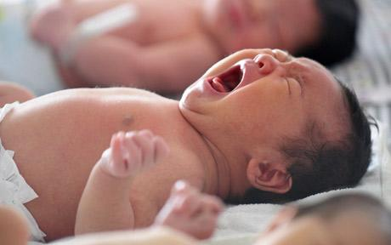
RISK FACTORS - HIE

Slide 9
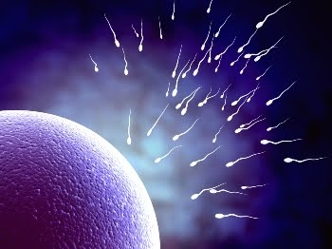
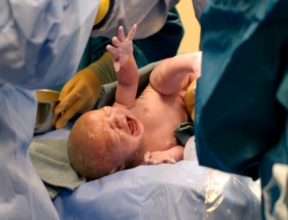
Preconceptional
IDDM
Thyroid
Infertility treatments
Nulliparity
Advanced maternal age

Slide 10
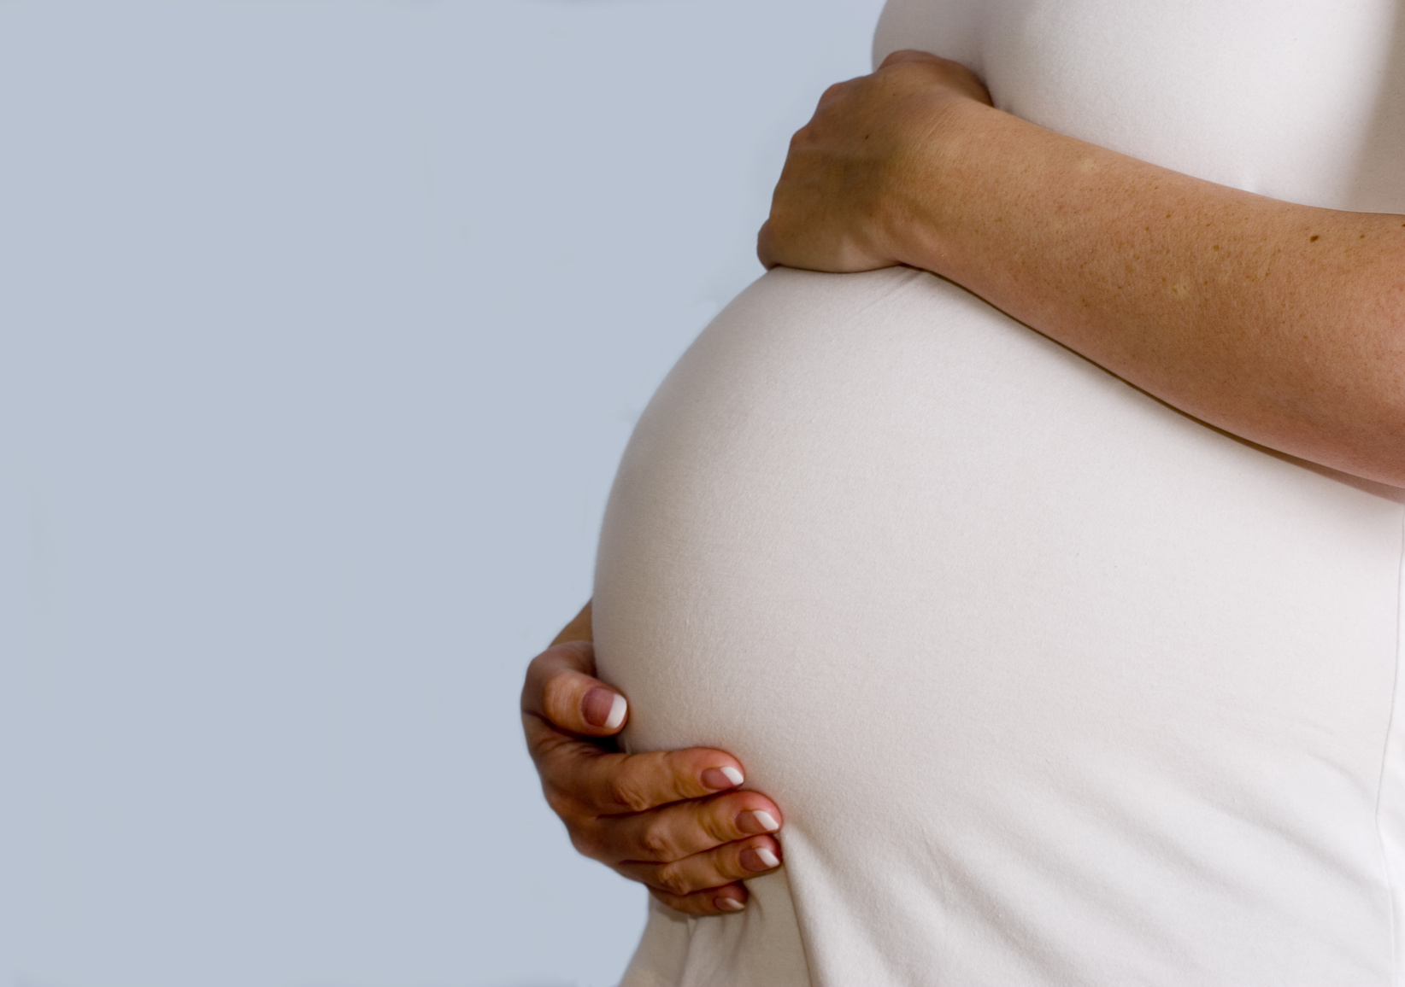
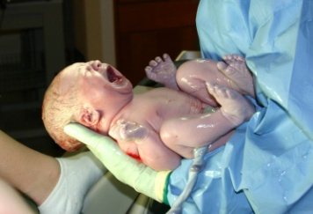
Antenatal risk factors
History of seizures
Viral illness during pregnancy
Abnormal placenta
Severe pre eclampsia
IUGR
MSAF

Slide 11

Intrapartum risk factors
Maternal pyrexia
Persistent OP position
Acute intrapartum events
Instrumental VD or emergency CS
Elective LSCS

Slide 12
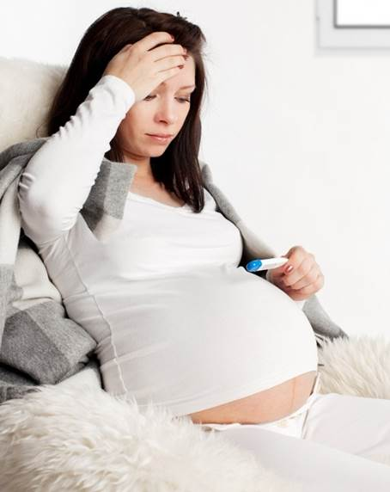
Maternal pyrexia and CP
Maternal intrapartum fever of >37.5 C has been shownt to increase the risk of perinatal brain injury and increase the risk of early onset neonatal seizures.

Slide 13
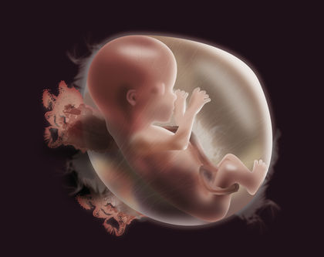
Chorioamninitis –risk factors
Maternal intrapartum fever of . 38 C persisting > 1hour is usually considered a clinical indicator of Chorioamnionitis.
Independent risk factor for CP[ among term and near term neonates.
“Dual Hit” → combined infection+ HI result in more severe brain injury.
One of the responsible factors for worse neurological outcome in low and mid income countries.

Slide 14
Role of cytokines -?? Final common pathways.
Higher level of IL-6 and IL-8 were seen in CSF of infants with HIE than control infant (Savman et al 1998).
Nelson et al observed that higher level of proinflammatory cytokines were seen in blood sample of cerebral palsy compared to those without.
Some studies shows IL-1 correlate best with outcome.

Slide 15
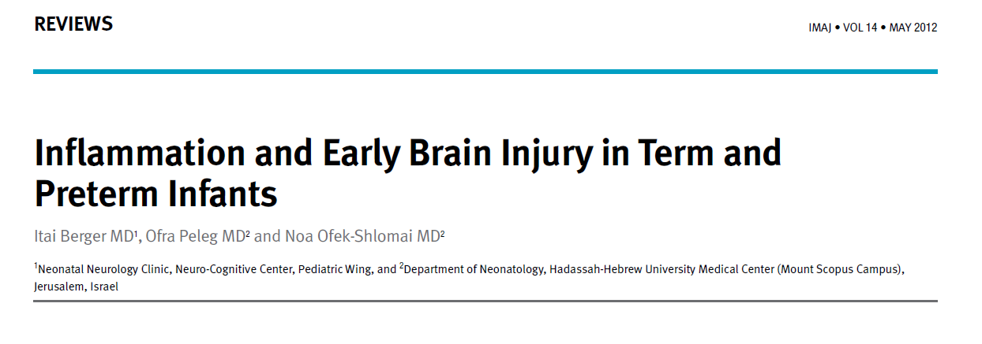
There is an association between antenatal inflammation, WMD and long-term motor and cognitive deficits.
Clearer understanding of the mechanisms and roles of key cellular and vascular components is crucial for the development of more effective prophylactic and therapeutic strategies.
Better markers are needed for a reliable, earlier and more certain diagnosis of the newborn at risk.

Slide 16
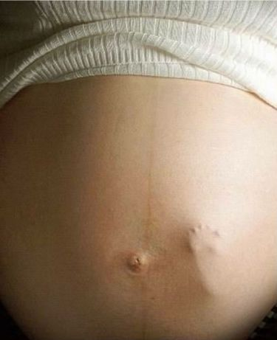
Fetal response to hypoxia

Slide 17
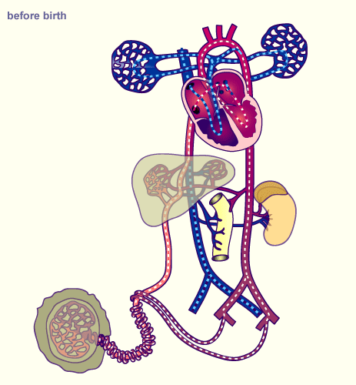
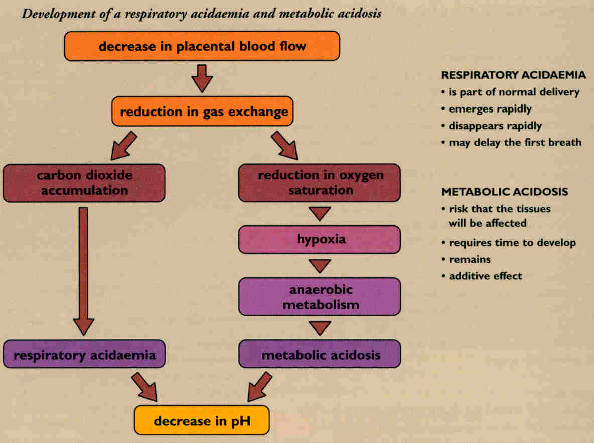

Slide 18
The foetal response to hypoxia
More effective uptake of oxygen
Reduced activity (fetal move.)
Surge of stress hormones
Redistribution of blood flow
Anaerobic metabolism
Decrease in growth rate (chron.)

Slide 19

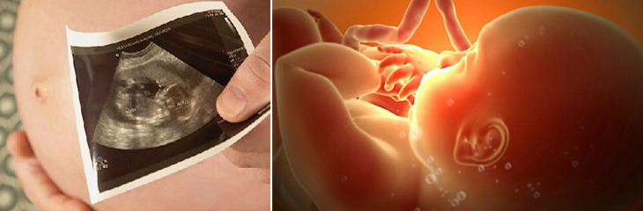
assessment of fetal well being

Slide 20
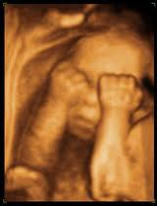
Sequential Changes in Tests of Fetal well being
Growth
Aortic
blood
flow
Moderate
severe
redistribn
Cerebral
blood
flow
Abnormal
FHR
Trace
Fetal size
less than
5th centile
Abnormal
venous
flow
Umbilical artery A/B
AFI
Oligohydramnios

Slide 21
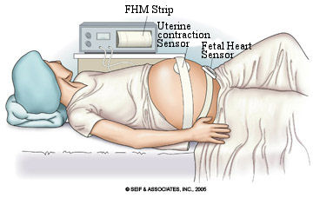
Biophysical profile

Slide 22
Scoring and management
BPP score | Interpretation | Recommended Mx
10 | Normal, nonasphyxiated | No fetal indication for intervention, rpt test weekly,twice weekly in DM and postdated preg
8 Normal fluid | Normal, nonasphyxiated fetus | No intervention
8 oligohydramnios | Chronic fetal asphyxia suspected | Deliver if >37 wks, otherwise rpt testing
6 | Possible fetal asphyxia | If AF vol abn,deliver If normal AF at >36 wk with fav cx-deliver If rpt test <6,deliver
4 | Probable fetal asphyxia | Rpt testing same day, if <6,deliver
0-2 | Almost certain fetal asphyxia | deliver

Slide 23


Biophysical profile
Five trials (2974)
No significant differences
  Perinatal death(RR) 1.33, 95% (CI) 0.60 to 2.98)
  Apgar score < 7 at 5 min(RR 1.27, 95% CI 0.85 to 1.92)
  Increased caesarian rate RR 1.60, 95% CI 1.05 to 2.44, n = 280, P = 0.03.
Insufficient evidence from randomised trials to support the use of BPP as a test of fetal wellbeing in high-risk pregnancies.

Slide 24
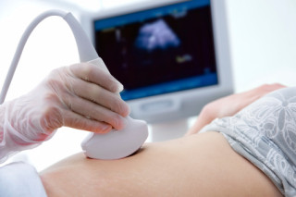
Doppler Velocimetry

Slide 25
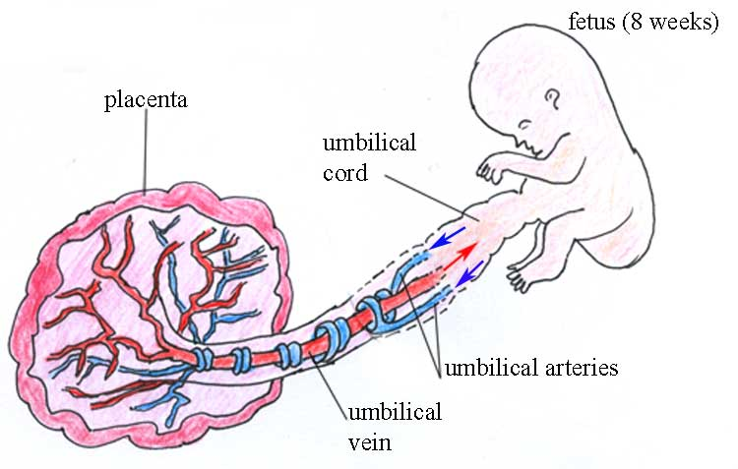
The most commonly studied vessel is the fetal umbilical artery.
Doppler measurements of the pulsatile blood flow in the umbilical arteries directly reflect the status of the fetomaternal circulation

Slide 26
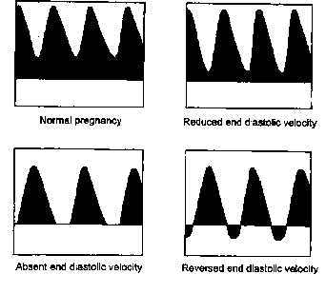
PRINCIPAL OF DOPPLER STUDY
A progressive decrease in placental function or blood flow
eventual absence or reversal of flow during diastole
increased resistance to flow as evidenced by a diminution in the diastolic flow

Slide 27

EVIDENCE – DOPPLER STUDY
Cochrane review of 11 randomized trials showed a trend toward decreased perinatal mortality with the use of Doppler assessment of the umbilical artery in high-risk pregnancies

Slide 28
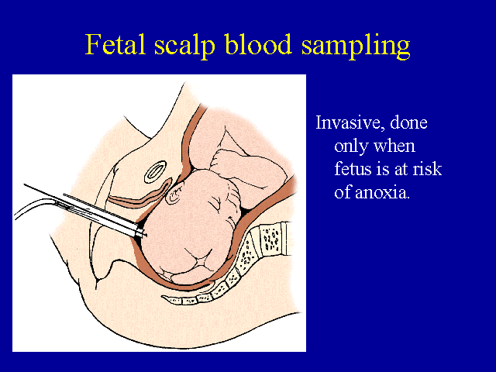
Fetal pH
FBS, using a blood sample obtained following a lancet cutaneous puncture, can reduce the increased operative intervention rates
Indicated in the presence of atypical and/or abnormal tracings.

Slide 29
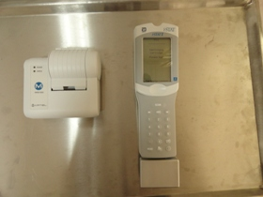
Classification of fetal scalp Ph value
Fetal blood sample (FBS) result (pH)* | Subsequent action
>= 7.25 | FBS should be repeated if the FHR abnormality persists
7.21–7.24 | Repeat FBS within 30 minutes or consider delivery if rapid fall since last sample
7.20 | Delivery indicated.

Slide 30
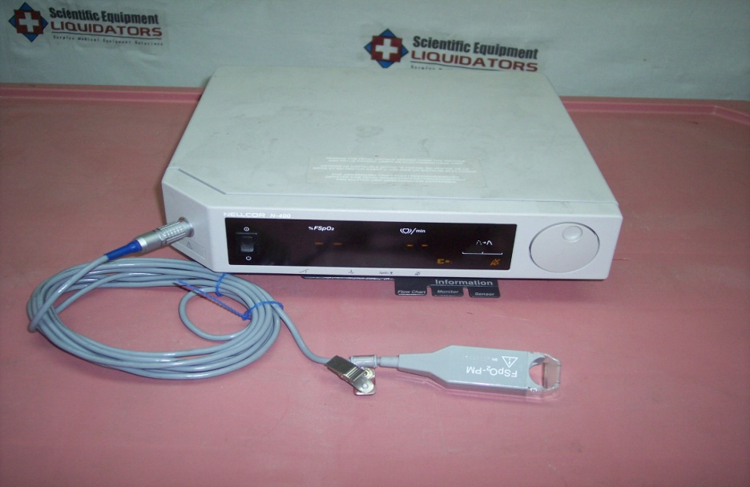
Fetal Pulse Oximetry
Technology that attempts to continuously monitor intrapartum fetal O2 saturation.
A sensor is placed transvaginally through the cervix to rest against the fetal cheek or temple, requiring cervical dilatation (~ 2 cm or more) and ruptured amniotic membranes with a cephalic presentation.

Slide 31
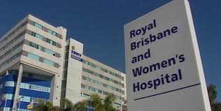
EVIDENCE STUDY-FPO
The effect of intrapartum fetal pulse oximetry, in the presence of a nonreassuring fetal heart rate pattern, on operative delivery rates: a multicenter, randomized, controlled trial
(FOREMOST trial)

Slide 32

The objective of the study was to compare operative delivery rates for nonreassuring fetal status between 2 groups of laboring women: those having conventional cardiotocograph monitoring and those having cardiotocograph monitoring plus fetal pulse oximetry.

Slide 33

There was a statistically significant 23% relative risk reduction in operative delivery for nonreassuring fetal status in the fetal pulse oximetry + cardiotocograph group compared with those in the cardiotocograph-only group.
saving of $A813 for each operative birth for non-reassuring fetal status averted by the addition of FPO to CTG monitoring compared with the use of CTG monitoring alone.

Slide 34

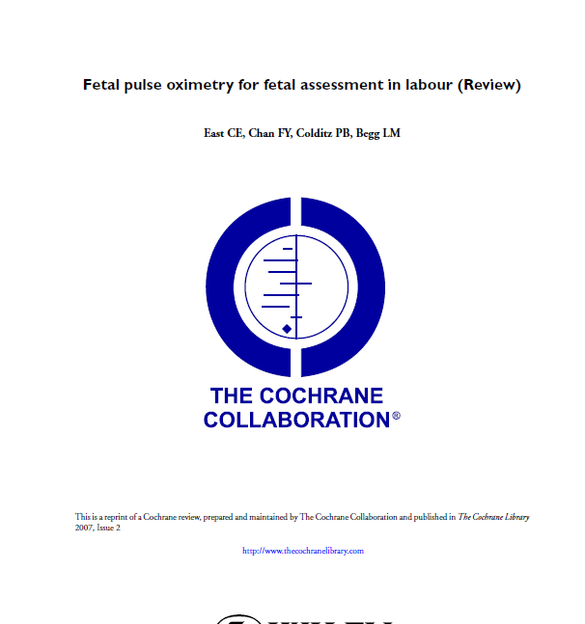
FPO- 2012 COCHRANE EVIDENCE
The data provide limited support for the use of fetal pulse oximetry when used in the presence of a nonreassuring CTG, to reduce caesarean section for nonreassuring fetal status.
The addition of fetal pulse oximetry does not reduce overall caesarean section rates. -

Slide 35
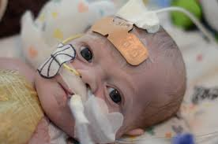
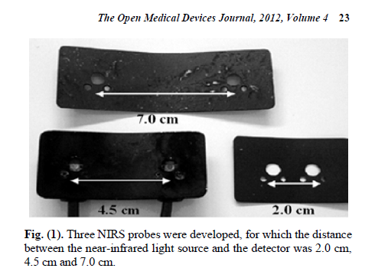
NIRS(near infrared spectroscopy)
A non-invasive method of detecting fetal hypoxaemia is an attractive proposition.

Slide 36
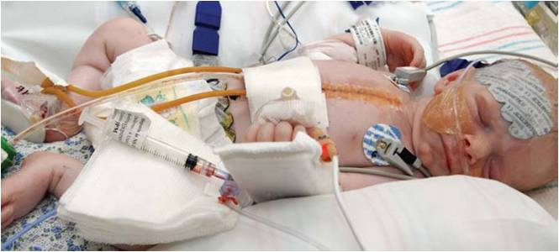
NIRS 2012 COCHRANE EVIDENCE
Near-infrared spectroscopy has been developed to directly measure fetal cerebral oxygenation, with a view toward identification of those fetuses truly at risk -

Slide 37
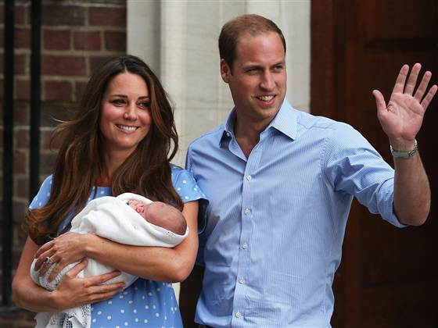
Labour is potentially the most dangerous period in an individuals life.
Inadequate methodology of surveillance currently being applied is highly unfortunate.
Much of the hypoxic ischemic injury evolve after cessation of insult and can be interrupted to a considerable extent.
Joseph Volpe

Slide 38
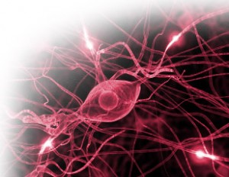
PATHOPHYSIOLOGY

Slide 39
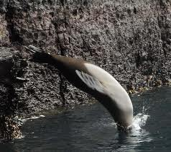
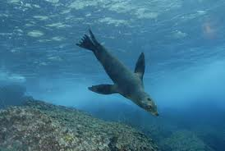

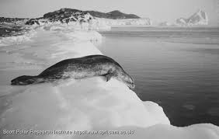
Hypoxia
Bradycardia
Peripheral vasoconstriction
Blood shift
Diving seal reflex
Away from lungs, kidney, gut & skin
Shunting of blood to brain adrenals & heart
Non-brain organ injury

Slide 40
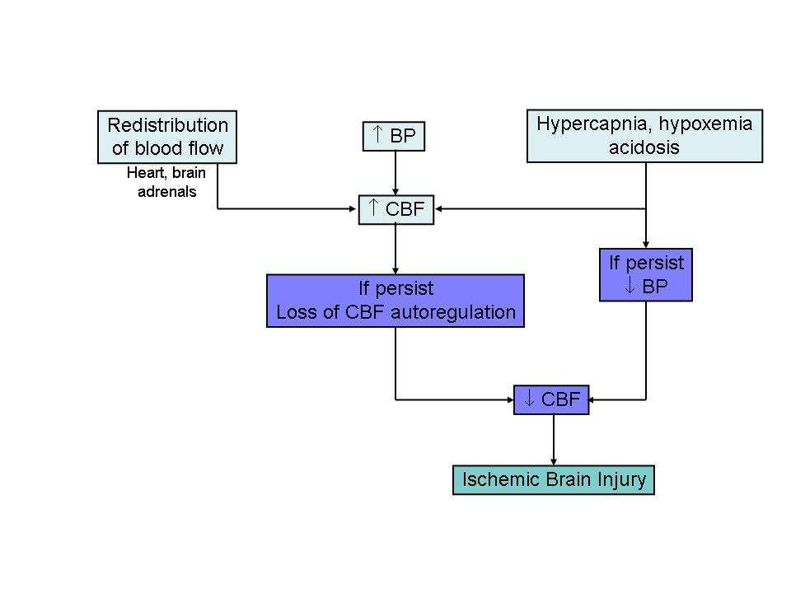
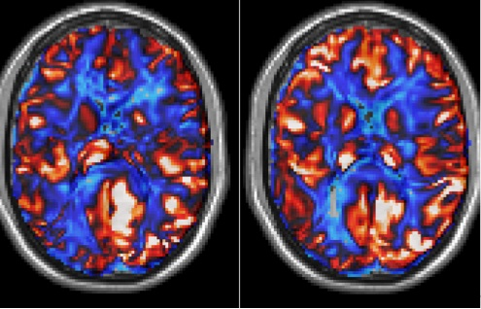
What happen to Cerebral blood flow??
Notes:
Fetal response to asphyxia illustrating the initial redistribution of blood flow to vital organs. With prolonged asphyxial insult and failure of compensatory mechanisms, cerebral blood flow falls, leading to ischemic brain injury. Dr. Volpe discussed the pathophysiology leading to the above lesions. The first was interference with blood flow to the brain due to systemic hypotension and by a failure of autoregulation of flow (Figure 2.7). Normally blood flow to the brain is kept constant despite changes in blood pressure. However in asphyxia this regulation may be lost so that as blood pressure drops, flow to the brain also drops (Figure 2.8). These changes produce ischemia, a major factor in the causation of brain damage. Ischemia then causes neuronal and oligodendogrial damage via excitoxicity

Slide 41
Cellular Mechanisms of Brain Injury-
Biochemical
Energy failure
Free radical formation
Accumulation of cytosolic Ca
Role of inflammation-cytokines
EXCITATORY AMINO ACID

Slide 42
Conceptual Model of HIE
Cerebral Blood Flow
Energy Metabolism
Membrane Depolarization
Glutamate release
Intracellular calcium
Free Radicals
Inflammation
Genetics

Slide 43
Cellular Mechanisms of Brain Injury- Biochemical
Energy failure
Free radical formation
Accumulation of cytosolic Ca
Role of inflammation-cytokines
EXCITATORY AMINO ACID

Slide 44
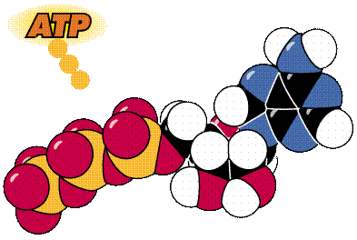
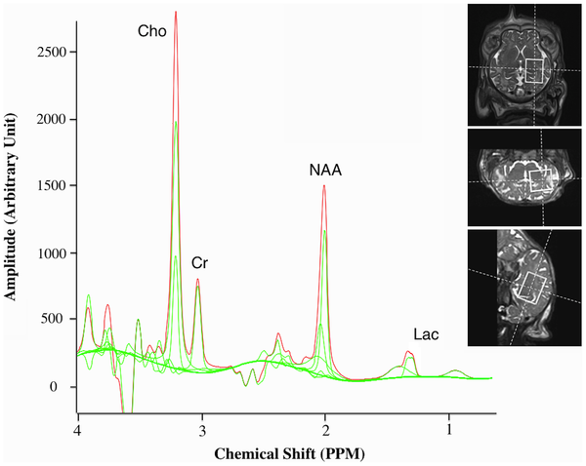
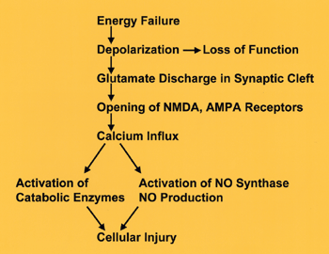

Slide 45
Role of Energy Failure
Primary energy failure:
ATP levels begin to fall after 2 min & decrease by 30% after 6 min
After 6 min. brain glucose levels decrease by 70% but in blood it increases by 100%
Secondary energy failure:
High energy phosphate levels which decline after acute insult, recover in 2-3 hrs
ATPs again starts declining and is at nadir at 24-48 hrs (Lorek et al:Pediatr Res 36:699-706,1994)
The cause is mitochondrial disturbances which occurred during primary insult and it continues, leading to secondary energy failure
(Holowach & Hauhart: Pediatr Res 7:691-695,1973)

Slide 46
Cellular Mechanisms of Brain Injury- Biochemical
Energy failure
Free radical formation
Accumulation of cytosolic Ca
Role of inflammation-cytokines
EXCITATORY AMINO ACID

Slide 47
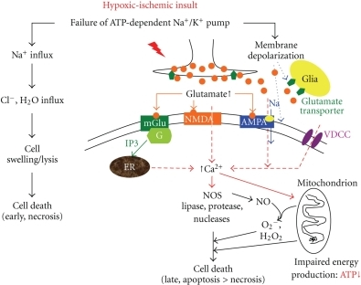

Slide 48
Relation b/w energy depletion & cell death
↓ATP
Failure of ATP dependent
Na+/K+ pump
Membrane depolarization
Na+ Influx
↓ Glutamate uptake
↑ Glutamate release
Cl & H2o influx
Cell swelling / lysis
↑ Glutamate
Early Cell Death
(Necrosis)
↑[Ca ²⁺ ]
Late Cell Death (Apoptosis > Necrosis)
Notes:
Ischemia: It causes reduced energy production and a fall in ATP, resulting in glutamate release, which in turn reacts with glutamate receptors (), causing changes in membrane function and especially an accumulation of calcium within the cell (). This causes damage by interfering with mitochondrial function and other direct effects resulting in the release of free radicals and cell death

Slide 49
Cellular Mechanisms of Brain Injury- Biochemical
Energy failure
Free radical formation
Accumulation of cytosolic Ca
Role of inflammation-cytokines
EXCITATORY AMINO ACID

Slide 50
Role of Accumulation of Cytosolic Ca⁺²
↓ATP
Adenosine
↑[Ca ²⁺ ]
NO Synthetase
lipases
Phospholipase
Protease
Nucleases
Cal. ATPase &
Uncouples
Oxida-phospho
Xanthine Oxidase
Hypoxanthine
Microtubular disruption
Nuclear
injury
NT release
(Glut. & Catechol.)
Free Radicals
Xanthine
Cytoskeletal Dysruption
Membrane injury
Cell Death

Slide 51
Cellular Mechanisms of Brain Injury-
Biochemical
Energy failure
Free radical formation
Accumulation of cytosolic Ca
Role of inflammation-cytokines
EXCITATORY AMINO ACID

Slide 52
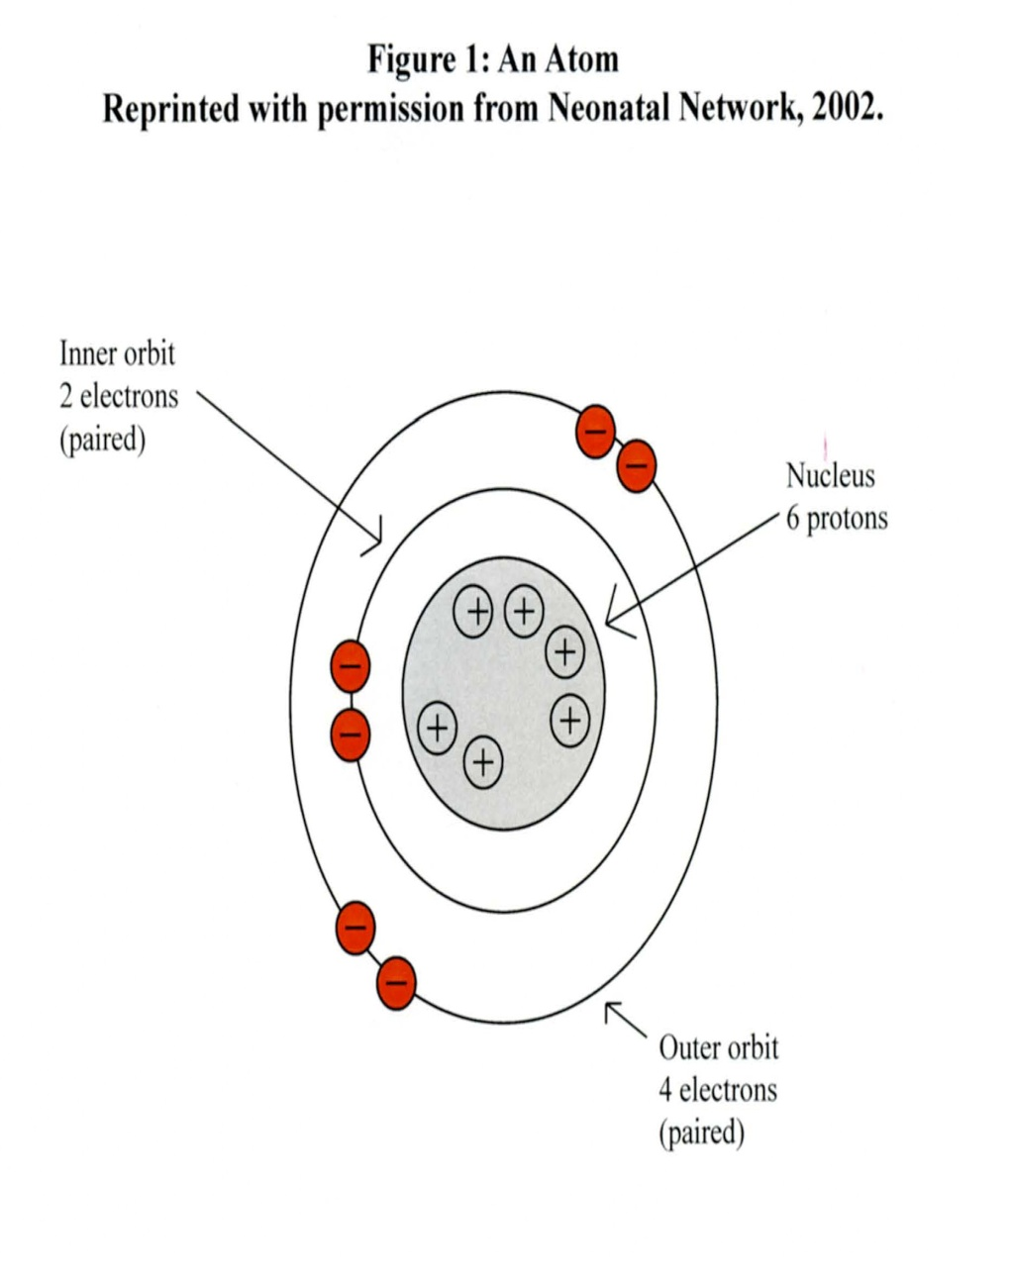
Free radicles
Highly reactive compounds with odd number of electrons in their outer orbital
React with cellular membrane components & generate further new free radicals, thus resulting in irreversible biochemical injury

Slide 53
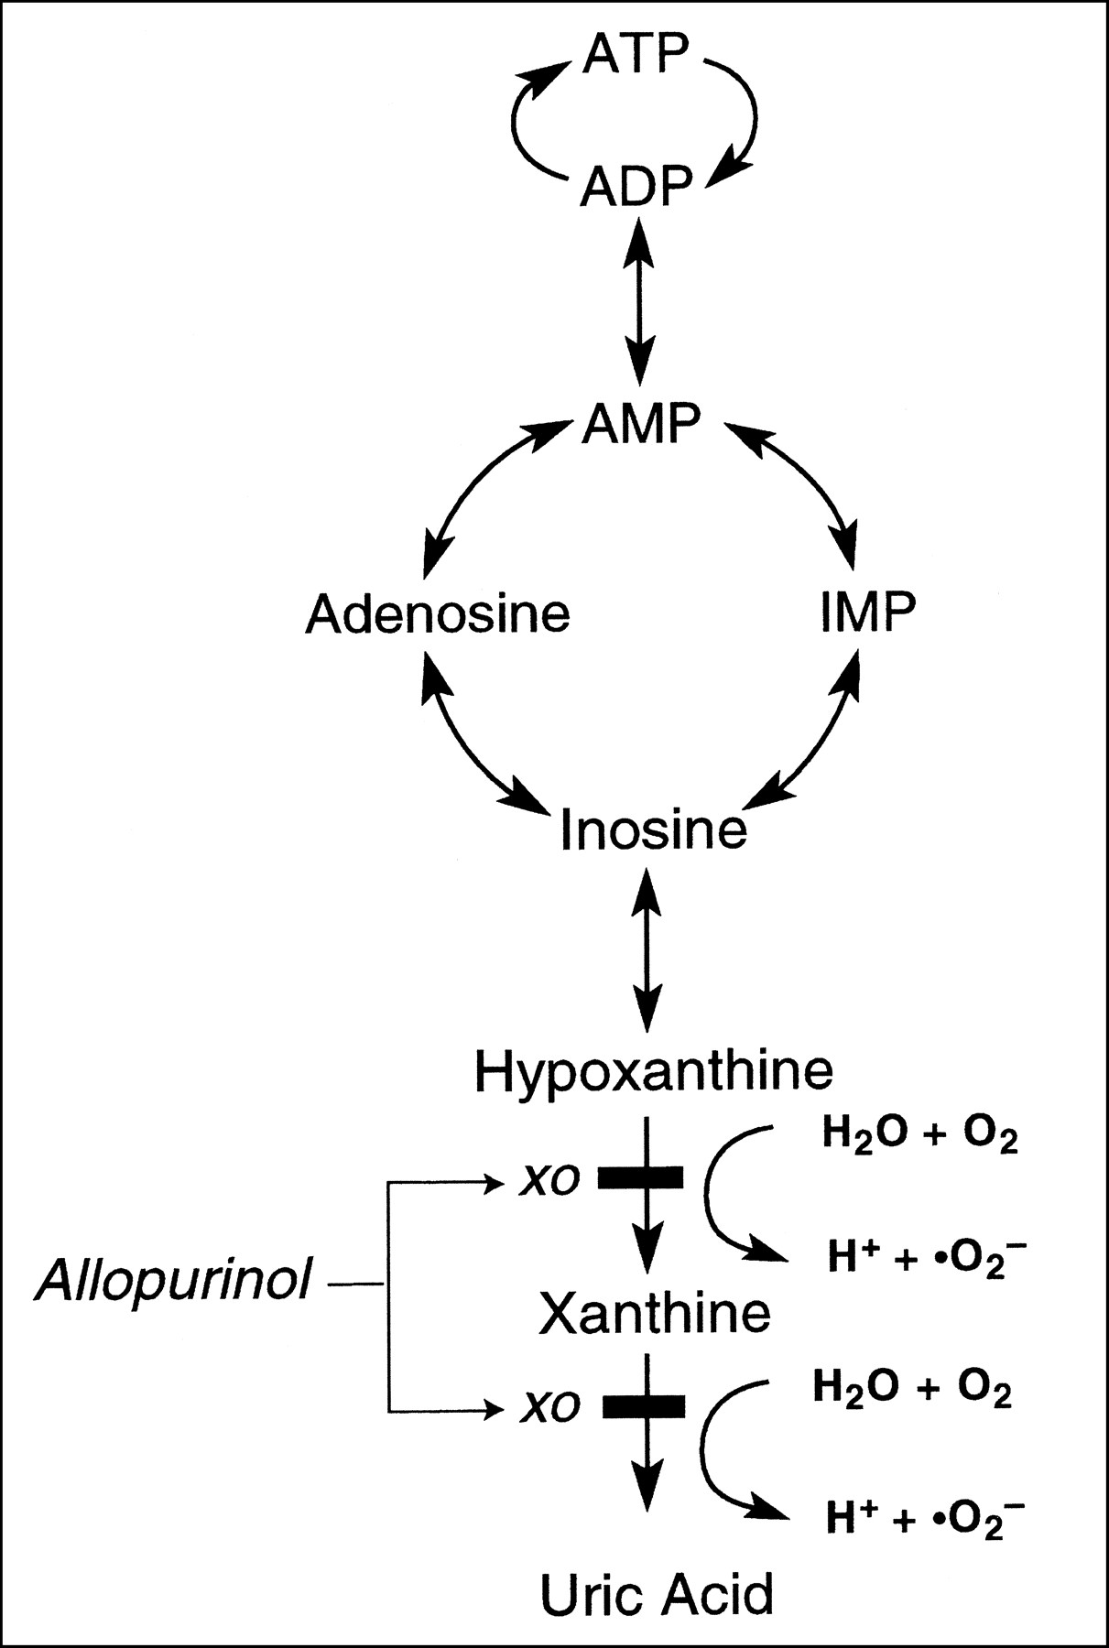
Free radicles
Neonatal brain has high con. Of PUFA in neuronal membranes and is deficient in anti-oxidant capacity; hence more prone to injury

Slide 54
EFFECT OF ROS
ROS
DNA strand breakage
Neutrophil accumulation
Lipid peroxidation
Membrane damage
PMN plugging of capillaries
Release of proteases, myeloperoxidase, prostaglandins
Cell death
Ischemia
Phagocytosis
Tissue damage

Slide 55
Cellular Mechanisms of Brain Injury- Biochemical
Energy failure
Free radical formation
Accumulation of cytosolic Ca
Role of inflammation-cytokines
EXCITATORY AMINO ACID

Slide 56
TNF a
IL 1
IL 2
IL 6
IL 8
PRO INFLAMOTORY
Inflammation
IL 10
IL 4
VEGF
NGF
IGF
ANTI INFLAMATORY
Genetics

Slide 57
Role of Inflammation-Cytokines
Activated microglia accumulate after 4 hrs of reperfusion & continue to increase upto 48 hrs
Neutrophils accumulate in brain vessels on reperfusion
Cytokines IL-1β & TNF-α promptly increase after hypoxic ischemic event
Antimicrobial (minocyclin) is neuroprotective
Infliction of oligodendroglial injury – pathogenesis of PVL

Slide 58
Gender difference
2005 survillance of CP in europe study reported that male babies are at higher risk for CP than female babies.
Cognitive and motor outcome was worse in male compare to female.

Slide 59

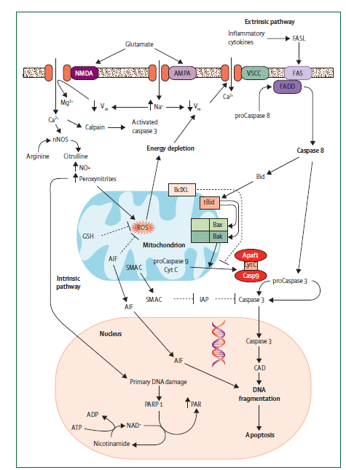
Female →neuron preferentially release cytochrome c and die as result of subsequent activation of Caspase 3 pathway
Male→ mainly die through apoptosis inducing factor(AIF)dependent pathways

Slide 60
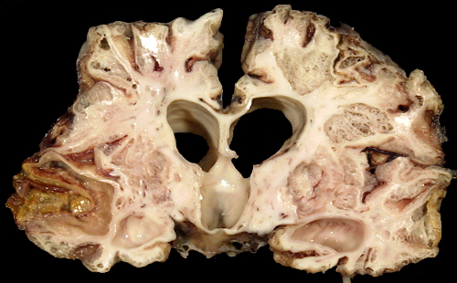
Neuropathological Varieties
Selective neuronal necrosis
Parasagittal cerebral injury
Periventricular leukomalacia
Focal (and multifocal)ischemic brain necrosis, stroke

Slide 61
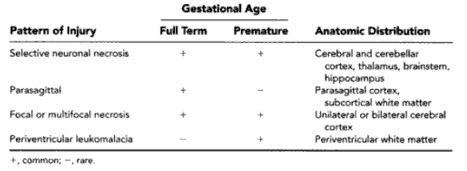
Neuropathological patterns
Histological evidence becomes apparent approx after 90 min (Vannuuci RC: Pediatr Res 27:317-326,1990)

Slide 62
Neuropathological Varieties
Selective neuronal necrosis
Parasagittal cerebral injury
Periventricular leukomalacia
Focal (and multifocal)ischemic brain necrosis, stroke

Slide 63
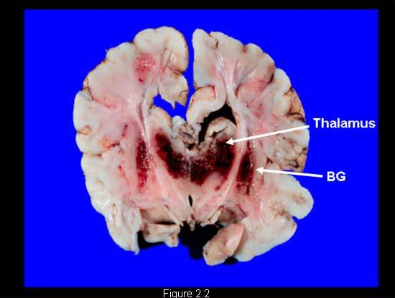
SNN – BGT(BASAL GANGLIA THALAMUS) PATTERN
Most common pattern
When there is sentinal events→ Acute near total asphyxia.
More severe neonatal signs
More intensive resucitation at birth
More severe encephalopathy
More severe seizures.
Predominatly affect BL central grey nuclei(thalamus & putamena),periloandic cortex.

Slide 64
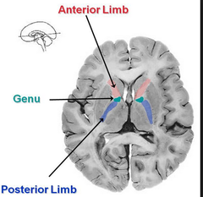
POSTERIOR LIMB OF INTERNAL CAPSULE
(PLIC)
PLIC is actively myelinating at term equivalent age
Very suceptible to injury at this stage
Damage to PLIC corellate with severity of BGT lesion.

Slide 65
Neuropathological Varieties
Selective neuronal necrosis
Parasagittal cerebral injury
Periventricular leukomalacia
Focal (and multifocal)ischemic brain necrosis, stroke

Slide 66
watershed infarcts
Parasagittal brain injury
Result from chronic partial hypoxia (ex.several hours of maternal hypotension)
Parasagittal cortex between anterior, middle, and posterior cerebral arteries (border zones)
Notes:
Figure 9. Definition of parasagittal distribution. Cerebral parenchyma between major vascular territories (ie, between the anterior cerebral arteries [ACA] and middle cerebral arteries [MCA] and between the middle and posterior cerebral arteries [PCA]) is called the watershed zone. In combination with the previously defined border zone (refer to Fig 2), the parasagittal parenchyma (areas shaded red on axial MR image) is at risk for ischemic injury from hypoperfusion.

Slide 67
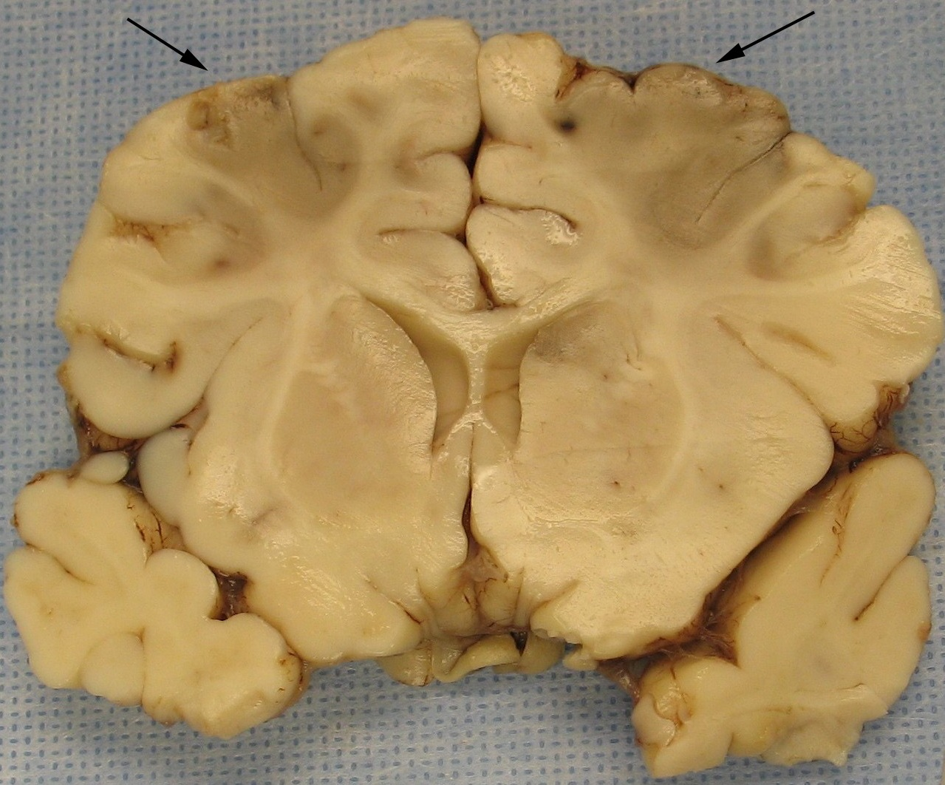
watershed infarct
Notes:
Bilateral acute infarctions of the frontal lobe are shown. The infarctions depicted in the figure (arrows) are consistent with watershed infarctions secondary to global hypoperfusion

Slide 68
Neuropathological Varieties
Selective neuronal necrosis
Parasagittal cerebral injury
Periventricular leukomalacia
Focal (and multifocal)ischemic brain necrosis, stroke

Slide 69
Neuropathological Varieties
Selective neuronal necrosis
Parasagittal cerebral injury
Periventricular leukomalacia
Focal (and multifocal)ischemic brain necrosis, stroke

Slide 70
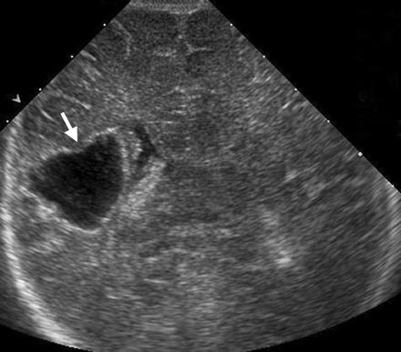
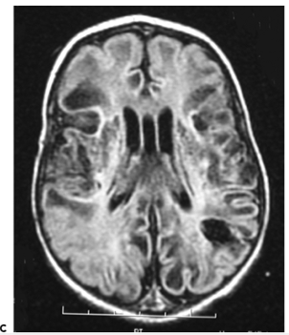
Focal & multifocal ischemic necrosis
Porencephaly- single u/l cavity due to infarction by a single major cerebral artery
Multicystic encephalomalacia- multiple foci of cerebral necrosis mainly in white matter

Slide 71
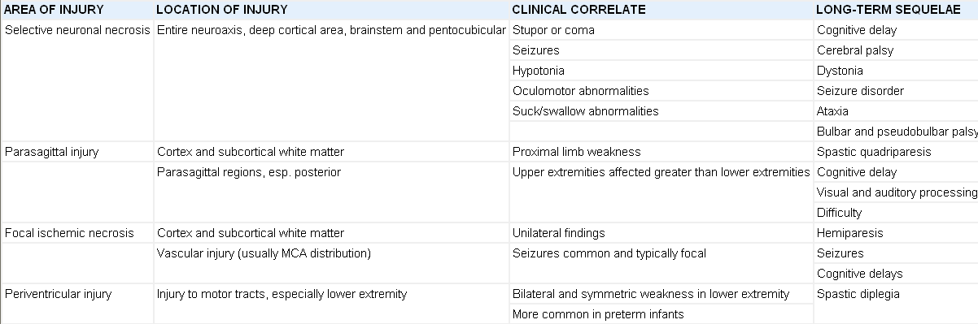
Neuropathological patterns & clinical features

Slide 72

Management OF HIE

Slide 73
Neurological assessment
Classification of HIE (Levene)
Feature
Mild
Moderate
Severe
Consciousness
Tone
Seizure
Sucking / Resp.
Irritable
Hypotonia
No
Poor Suck
Lethargy
Marked
Yes
Unable to suck
Comatose
Severe
Prolonged
Unable to sustain spont. Resp.

Slide 74
Clinical parametres | Stage 1 (mild) | Stage 2 (moderate) | Stage3 (severe)
Level of consciousness | Alert | Lethargy | Coma
Seizures | No | Common | Decerebration
Sucking | Active | Weak | Absent
Moro’s | Exaggerated | Incomplete | Absent
Grasping | Normal/exaggerated | Exaggerated | Reduced/absent
Doll’s eye/ oculocephalic reflex | Normal | Over-reactive | Reduced/absent
Muscle tone | Normal | Hypotonia | Flaccidity
Myoclonus | Present | Present | Absent
Tendon reflexes | Normal/increased | Increased | Depressed/absent
Duration | < D1 | D1-D5 | > 5 D
(Data from Sarnat & Sarnat (relevant in term newborns only)

Slide 75
Kidney is a window to the brain.
Target organs of perinatal asphyxia
  Kidneys 50%
  Brain 28%
  Heart 25%
  Lung 23%
  Liver, Bowel, Bone marrow < 5%

Slide 76
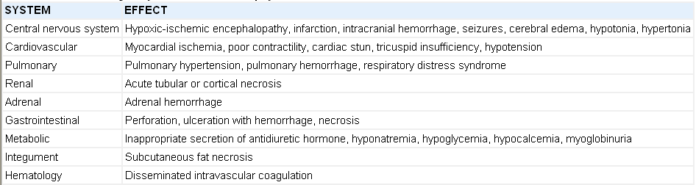
Multi organ dysfunction

Slide 77

Delivery room Management

Slide 78
Normal umbilical cord blood PH and blood gas values in term newborns
Value | Mean (+/- 1SD) | Range
Arterial blood
pH pCO2 (mm Hg) HCO3-(meq/L) Base excess (meq/L) | 7.27 (0.069) 50.3 (11.1) 22.0 (3.6) –2.7 (2.8) | 7.2–7.34 39.2–61.4 18.4–25.6 –5.5–0.1
Venous blood
pH pCO2 (mm Hg) HCO3-(meq/L) Base excess (meq/L) | 7.34 (0.063) 40.7 (7.9) 21.4 (2.5) –2.4 (2) | 7.28–7.40 32.8–48.6 18.9–23.9 –4.4–0.4
pH less than 7 and base deficit greater than or equal to 12 mmol/L

Slide 79

Delivery room Mx
O2 use cause free radicle mediated injury and pulmonary atelectasis.

Slide 80
Clinical Mx In NICU

Slide 81

INVESTIGATION
First line
Cord blood gas and lactate
Niochemistry,hematology,metabolic parametres
Cardiac and hepatic enzymes
Screen for infection
Test for congenital infection
Cranial USG/EEG/aEEG
MRI within 14 days

Slide 82

2ND LINE IX
Metabolic or genetic disorder if any dysmorphic features,parental consaguinity,abnormal intracranial anatomy,Severe growth restriction,unusual pattern of injury on MRI.

Slide 83

3rd line Ix
Ix for rare metabolic disorder
Ix for NM disorder
Thrombophillia screen
Store blood for future DNA analysis

Slide 84

Neurological monitoring
EEG/aEEG

Slide 85


SEIZURES
sudden increase in voltage,
narrow band aEEG & period
of suppression)

Slide 86

Temperature monitoring
Continuous core temperature monitoring using rectal or esophageal probe and therapeutic hypothermia if possible.

Slide 87

Ventilation and Oxygenation
O2
Severe hyperoxemia (po2=200 mm hg)and severe hypocapnea(pco2<20 mm hg) have been associated with adverse outcome, hence must be avoided.
Oxygen = ventilation,,rigorously controlled.
Hypocapnea, decrease CBF→INCREASE risk of ischemic injury.

Slide 88
Indications for ventilation
CO2
Frequent apnoea, PCO₂>7 kPa,
hypoventilation secondary to anticonvulsants, meconium aspiration syndrome/pulmonary hypertension
Maintain PCO₂ 4.0-6.5 kPa

Slide 89

Cardiac dysfunction
Decrease ventricular function
Abnormalities of rate and rhythm
TR
Hypotension
Maintain mean arterial pressure >40 mmHg in term infants
Ionotropic support may be required.

Slide 90



nirs

Slide 91



Slide 92
FLUID & Metabolism
Restrict to 20% less than maintenance electrolytes for first 48 hours (anticipating SIADH or renal failure)
Aim for neutral fluid balance (I.e replacement of losses)
Treat hypocalcaemia if Ca< 1.7 mmol
Maintain normoglycemia
Provide adequate protein and caloric intake

Slide 93
Coagulopathy and other organ damage
HIE can lead to DIC, decrease level of coagulation factors and thrombocytes.→prolonged bleeding time
ATN →temporary, resolve over 1 week time.
Renal damage vary from mild to severe renal failure,however permenent damage is very rare.
Liver enzyme: elevated due to damage.
Hypocalcemia
Hypomagnesemia
Sodium abnormalities

Slide 94


NEUROPROTECTION

Slide 95

Timeframe of potential strategies for neuroprotection

Slide 96
HIE : PROPOSED INTERVENTIONS
Energy
Metabolism
Excitatory
Glutamate
Inflammatory
Mediators
Calcium
Mediated
effects
Free Radicals
Nitric Oxide

Slide 97

“Early”
Neuro-protective strategies

Slide 98
Therapeutic Hypothermia
Eligible neonates:
>35 weeks gestation
< 6hrs post birth

Slide 99
Early neurologic evaluation
Category | Signs of Encephalopathy
 | Moderate | Severe
Consciousness | Lethargic | Stupor/coma
Spontaneous activity | Decreased | None
Posture | Distal flexion, complete extension | Decerebrate
Tone | Hypotonia | Flaccid
Primitive reflexes
Suck | Weak | Absent
Moro | Incomplete | Absent
Autonomic system
Pupils | Constricted | Deviated/Dilated/Non-reactive
Heart rate | Bradycardia | Variable
Respiration | Periodic | Apnea
Notes:
This is the early neurologic evaluation that was used at entry into the whole body hypothermia trial. You can notice that there are multiple categories such as consciousness, spontaneous activity, posture, tone, reflexes such as the suck and Moro, and evaluation of the pupils, heart rate, and respiration.

Slide 100

Therapeutic
Window:
Hypothermia
Other

Slide 101

Reduction in glutamate release
Prevention of blood-brain barrier disruption
and brain edema
Decrease in intracellular acidosis
and lactic acid accumulation
Preservation of endogenous
antioxidants
Reduction of leukotriene
production
Inhibition of apoptosis
Reduction in cerebral metabolism

Slide 102

Historical Origins of Cooling Babies!!
Hippocrates
John Floyer in1679 used a tub of ice to revive an infant who was not crying at delivery
James Miller and Bjorn Westin in the 1950s developed a scientific rationale for the use of hypothermia in "asphyxia neonatorum” in first case series
Dropped out of favor after Silverman paper in Pediatrics 1958
(Wyatt et al.Pediatrics 1997)
Notes:
Hippocrates: prolonged survival of exposed babies. Miller and Westin started in 1950 with animal studies, then 10 babies placed in ice with cold blood transfusion temp 27-30. Then in late 1950’s treated 65 babies with cooling with 52/65 survival and minimal CP outcomes. Rationale was decreased cerebral metabolism protective. Continued to champion cooling into 1970’s until Silverman paper with 150 premature infants nursed in hypothermic vs normothermic incubators with poor outcome for hypothermia.
102

Slide 103


Cool Cap Trial
Notes:
103

Slide 104




Olympic Cool Cap^{R} System
Cerebral function monitor
Notes:
104
104

Slide 105
The Cool Cap Trial :
Primary Outcomes
Final Count
234
Lost to Follow-up
16
18-Month
Primary Outcome
218
Cooled
108
Control
110
Favourable
49 (45%)
Unfavourable
59 (55%)
Favourable
37 (34%)
Unfavourable
73 (66%)
Slide Courtesy of Dr Suhas Nafday, Director of Neonatal Cooling Program
Gluckman P et al Lancet 365: 663, 2005
Notes:
105
218 babies – SHC to 34-35 degrees x 72 hr with moderate to severe enceph- CFM +

Slide 106

Intermediate aEEG group – cooled vs control odds ratio 0·47
95% CI 0·26–0·87, p=0·021
Notes:
106

Slide 107
The Cool CAP trial : Adverse Effects
No increase in severe hypotension despite full volume and inotrope support: 3 cooled vs. 3 non-cooled infants (p=1.00)
Scalp edema common (32 cooled and 1 control infant, p<0.0001), but transient
One case of scalp damage under the cap in an infant dying of severe hypotension and coagulopathy
Sinus bradycardia, without hypotension, was very common during cooling and reversed on rewarming
Slide Courtesy of Dr Suhas Nafday
Gluckman P et al Lancet 365: 663, 2005
Notes:
107

Slide 108

WHOLE BODY COOLING

Slide 109
What is the difference between Whole body cooling and Selective head cooling?
WBC provides homogenous cooling to all structures of brain (peripheral and central) Laptook et al Pediatrics 2001
SHC combined with some body cooling provides cooling to the peripheral structures but minimizes temperature gradients across the brain (Thorensen et al. Ped Res 2001)
SHC may have less adverse side effects than WBC cooling
Slide Courtesy of Dr Suhas Nafday, Director of Neonatal Cooling Program at CHAM
Notes:
109

Slide 110

HYPOTHERMIA-RCTs

Slide 111

Hypothermia: systematic review and meta analysis: Prakash Shah, Canada 2010

Slide 112

Hypothermia: systematic review and meta analysis: Prakash Shah, Canada 2010

Slide 113

Additional neuroprotective agents
Despite treatment with therapeutic hypothermia, almost 50% of infants with neonatal encephalopathy still have adverse outcomes.
Additional treatments are required to maximize neuroprotection

Slide 114

ERYTHROPOIETIN – HOW IT WORKS??
Modulation of the inflammatory and immune responses,
Vasogenic and proangiogenic effects through its interaction with VEGF as well as effects on central nervous system (CNS) development and repair.

Slide 115


EPO –EVIDENCE

Slide 116


Zhengzhou University, Zhengzhou, China
The purpose of this study was to evaluate the efficacy and safety of erythropoietin in neonatal hypoxic-ischemic encephalopathy (HIE), by using a randomized, prospective study design.
METHODS:
A total of 167 term infants with moderate/severe HIE were assigned randomly to receive either erythropoietin (N = 83) or conventional treatment (N = 84).
Recombinant human erythropoietin, at either 300 U/kg (N = 52) or 500 U/kg (N = 31), was administered every other day for 2 weeks, starting <48 hours after birth.
The primary outcome was death or disability. Neurodevelopmental outcomes were assessed at 18 months of age.

Slide 117

Erythropoietin improved long-term outcomes only for infants with moderate HIE (P = .001) and not those with severe HIE (P = .227).
No negative hematopoietic side effects were observed.
CONCLUSION:
Repeated, low-dose, recombinant human erythropoietin treatment reduced the risk of disability for infants with moderate HIE, without apparent side effects.

Slide 118

Xenon

Slide 119

What is xenon?
Xenon is an odourless, dense noble gas with anaesthetic properties.
It is present in the atmosphere in very small quantities.
It is used in light bulbs and headlights for cars, where it gives off a purple-blue light

Slide 120

How xenon is helpful in HIE?
Xenon’s neuroprotective properties have been demonstrated in cell culture rodent model of hypoxia-ischaemia and a neonatal pig model of global hypoxiaischaemia
Xenon acts as an N-methyl- D-aspartate (NMDA) receptor antagonist by binding to the glycine site of the receptor.
This prevents post-synaptic binding of glutamate, which is an excitatory neurotransmitter.
Xenon may also have anti-apoptotic effects.

Slide 121


Slide 122


Slide 123
‘ Does xenon provide additional neuroprotection if used in combination with therapeutic hypothermia?’
Two randomised trials are currently recruiting infants to investigate the neuroprotective effects of xenon in combination with cooling.
It will be very exciting to see the outcome of both trials, which use a different dose and duration of xenon. Even though the

Slide 124

Topiramate

Slide 125

FDA-approved anti-epileptic for patients older than 2 years.
It has been shown to protect newborn rodents from excitotoxic brain lesions, reducing brain damage and cognitive impairment when administered within 2 hours of the insult.
Reducing calcium overload in the ischemic cells and by increas the seizure threshold.

Slide 126



Slide 127

STUDY PROTOCOL
27 consecutive asphyxiated newborns who were treated with whole body hypothermia and 27 additional consecutive newborns with hypothermia who were co-treated with oral topiramate, once a day for 3 consecutive days, at 2 different doses.(8.2 to 26.0 mg/kg/day)

Slide 128
RESULT
There were no statistically significant differences in the groups in short-term outcomes, survival rate at discharge, or incidence of pathologic brain magnetic resonance imaging.
the short-term outcome and the safety data appear to support the evaluation of topiramate in clinical trials to explore its possible additive neuroprotective action.
(J Pediatr 2010;157:361-6)

Slide 129

LEVETERACETAM NEUROPROTECTIVE AGENT
regulate AMPA and NMDA receptor-mediated excitatory synaptic transmission in the dentate gyrus of the hippocampus by acting on the presynaptic P/Q-type voltage-dependent calcium channel,
reducing glutamate release, and
inhibiting the amplitude of excitatory postsynaptic current in the dentate gyrus.

Slide 130

LEV – AS NEUROPROTECTIVE AGENT
In contrast to several traditional AEDs, such as phenobarbital and phenytoin, LEV does not induce cell death in the developing brain even in doses several fold higher than therapeutic doses.

Slide 131


This study is the first to show the neuroprotective effects of levetiracetam in a neonatal rat model of hypoxic-ischemic brain injury using histopathological, biochemical, and late-period behavioral experiments within the same experimental group.

Slide 132

LEV – AS NEUROPROTECTIVE AGENT
RESULTS:
This study showed histopathologically that levetiracetam reduces the number of apoptotic neurons and has a neuroprotective effect in a neonatal rat model of hypoxic-ischemic brain injury in the early period.
Dose dependently improves behavioral performance in the late period

Slide 133
Viagra on pulmonary hypertension
Hour of age after sildenafil | 0hr | 6hr | 12 hr | 18hr
case-1 | 29 | 25 | 24 | 19
case-2 | 26 | 26 | 25 | 20
case-3 | 33 | 31 | 31 | 24
acse-4 | 35 | 34 | 32 | 29
case-5 | 32 | 30 | 29 | 25
case-6 | 29 | 26 | 24 | 20
case-7 | 37 | 36 | 34 | 30
case-8 | 33 | 31 | 29 | 25
case-9 | 27 | 27 | 25 | 24
case-10 | 34 | 32 | 31 | 25
case-11 | 34 | 34 | 30 | 28
Rajiv et al BMJ.june 2002

Slide 134
Viagra and HIE follow up
Age in yrs | 1yr | 2yrs | 3yrs | 4yrs | 5yrs
case-1 | 75 | 80 | 90 | 85 | 85
case-2 | 90 | 80 | 75 | 85 | 80
case-3 | 80 | 75 | 80 | 70 | 90
acse-4 | 79 | 80 | 85 | 75 | 75
case-5 | 80 | 80 | 90 | 90 | 85
case-6 | 80 | 75 | 80 | 80 | 75
case-7 | 70 | 75 | 80 | 75 | 80
case-8 | 80 | 90 | 90 | 85 | 90
case-9 | 75 | 85 | 75 | 75 | 85
case-10 | 90 | 85 | 90 | 85 | 85
case-11 | 75 | 80 | 70 | 75 | 75
AWAITING PUBLICATION 2014

Slide 135


AUTOLOGUS UC BLOOD– STEM CELL

Slide 136

AUTOLOGUS UC BLOOD– STEM CELL
This is an attractive idea because the immediate availability of autologous cord blood after delivery of an infant meant that the benefit of any infused stem cell would likely be greatest soon after the injury has occurred, especially during the reperfusion phase.
In addition there would be no problem of HLA incompatibility, and the nucleated cell viability of fresh cord blood would be better than cryopreserved cord blood units.

Slide 137


Feasibility of autologous cord blood cells for infants with hypoxic-ischemic encephalopathy.
Cotton CM et al,2012 @ DUKE UNIVERSITY

Slide 138
Twenty-three infants were cooled and received cells. Median collection and infusion volumes were 36 and 4.3 mL. Vital signs including oxygen saturation were similar before and after infusions in the first 48 postnatal hours. Cell recipients and concurrent cooled infants had similar hospital outcomes. Thirteen of 18 (74%) cell recipients and 19 of 46 (41%) concurrent cooled infants with known 1-year outcomes survived with scores >85.
CONCLUSIONS:
Collection, preparation, and infusion of fresh autologous UCB cells for use in infants with HIE is feasible. A randomized double-blind study is needed.

Slide 139
Prognosis in HIE
Usually by a neurological examination
The Sarnat and Sarnat stages predict long-term outcome, but are often determined well after birth (Sarnat & Sarnat Arch Neurol. 1976)
How useful is an early neurologic evaluation?
Which parts of the neurologic evaluation are useful?
Notes:
Prognosis in HIE is usually determined by a neurological examination. The Sarnat and Sarnat stages predict long term outcome, but are often determined well after birth. It is important to know how useful is an early neurologic evaluation, and which parts of the neurologic evaluation are useful.

Slide 140

Amplitude Integrated EEG
Good prognostic indicator immediately after birth on future neurodevelopment status
Assess the background activity of a compressed EEG

Slide 141
PROTON MRS –Evaluation of cerebral energy metabolism
Provide important prognostic data during the first week
Reduction in Nacetyl aspartate and elevation of Lactate in the thalamus /basal ganglia(increase Lac/NAA ratio)correlate with adverse outcome.
Earliest indicator of neurological handicap

Slide 142
.
Normal neonatal proton spectra
The spectrum reveals:
1) a small myoinositol peak,
2) a large choline peak,
3) two small creatine/phosphocreatine peaks,
4) a medium-sized NAA peak.
©1999 by American Society of Neuroradiology
Notes:
Location of voxels and normal neonatal proton spectra. A, The deep gray nuclei voxel includes most of the lentiform nucleus, the ventrolateral thalamus, and the posterior limb of the internal capsule. The spectrum reveals: 1) a small myoinositol peak, 2) a large choline peak, 3) two small creatine/phosphocreatine peaks, and 4) a medium-sized NAA peak.B, The watershed voxel includes primarily white matter from the intravascular boundary zone. Note that the NAA and choline peaks are relatively smaller in the less mature watershed zone than in the more mature deep gray nuclei. Minimal or no lactate was seen in most patients who were developmentally normal at 12 months.

Slide 143

Neonate with basal nuclei pattern of injury.
The basal nuclei voxel (A) shows marked elevation of the lactate peak (L) centered at 1.31 ppm.
1405
Barkovich A J et al. AJNR Am J Neuroradil
Notes:
Neonate with basal nuclei pattern of injury. A and B, The basal nuclei voxel (A) shows marked elevation of the lactate peak (L) centered at 1.31 ppm. In this acute phase, the relative sizes of the choline, creatine, and NAA peaks are normal. The watershed voxel (B) shows less elevated lactate (compare with A).

Slide 144

Neonate with watershed pattern of injury.
Both spectra show some lactate elevation at 1.31 ppm.
The spectrum from the basal nuclei voxel (A), however, shows a relatively smaller elevation of lactate (filled arrow) than the spectrum (open arrow) from the watershed voxel (B).
Notes:
Neonate with watershed pattern of injury. A and B, Both spectra show some lactate elevation at 1.31 ppm. The spectrum from the basal nuclei voxel (A), however, shows a relatively smaller elevation of lactate (filled arrow) than the spectrum (open arrow) from the watershed voxel (B).

Slide 145
RESISTIVE INDEX(RI)
Doppler assessment helps in measurement of cerebral blood flood velocity (cerebral hemodyanamics)
The cerebral blood flow velocities initially increase due to hyperperfusion and later decrease in those who develop HIE.
RI < 0.50 or >0.90 in the cerebral blood vessels is associated with immediate and long term poor outcome,
RI > 1.0 would be associated with later brain death.
If the RI in a baby with encephalopathy is abnormal on day 1, this suggests that an insult occurred in the 1-2 days preceding birth

Slide 146

Role of MRI
Useful in prognosis
Imaging biomarkers of HIE
DWI detect lesion earlier than T1-T2 weighted images.

Slide 147
sites of abnormality
basal ganglia and thalami
internal capsule
cortex
subcortical white matter
medial temporal lobe
brainstem
Increased metabolic rate
Actively myelinating
Increased glutamate receptors

Slide 148

NORMAL PLIC
NORMAL POSTERIOR LIMB OF INTERNAL CAPSULE

Slide 149

NORMAL
BASAL GANGLIA AND THALAMUS
BGT

Slide 150
Mild BGT
CP-10-15%
NORMAL PLIC
EQUIVOCAL PLIC
Walking at 2 yrs
2/3 walking at 2 yr,some may start later

Slide 151

Mild; Focal with normal PLIC

Slide 152
Moderate BGT
Look at PLIC
Equivocal PLIC
ABNORMAL PLIC
CP-60%,mostly mild,2/3 rd will be walking
CP-75%,MODERATE-50%,SEVERE 40%,70-80% WILL NOT WALK AT 2 YEARS

Slide 153

Abnormal signal intensity within the
PLIC (arrow) predicts abnormal motor
outcome
Sensitivity= 0.9 Specificity = 1.0 *

Slide 154
SEVERE BGT
CP – 98%
MOSTLY SEVERE
90% FEEDING PROBLEMS
95% WILL HAVE SOME SPEECH PROBLEMS
SEIZURE
Look at CORTEX
50-75% WILL HAVE SOME GRADES OF VISUAL IMPAIRMENTS
NORMAL-25-30%
MILD-45-50%
MODERATE-60%
SEVERE-75%

Slide 155

Severe; widespread
with abnormal PLIC

Slide 156
Predictors of poor
neuro developmental outcome
Failure to establish respiration by 5 minutes
Apgar 3 or less in 5 mts
Onset of Seizure in 12 hrs
Refractory convulsion
Stage III HIE
Inability to establish oral feed by 1 wk
Abnormal EEG & failure to normalise by 7 days of life
Abnormal CT, MRI, MR spectroscopy in neonatal period

Slide 157



